Slide 1


Tottenham 1–2 Aston Villa | Oct 19, 2025 | Premier League
THFC
0.1
STARTING 11
0.4
BHA
FRANK
OVERALL RATING
STARTING 11
ON-FIELD TACTICS
SUBSTITUTIONS
REF
QUOTE OF THE MATCH

Slide 2



0.1
1.1
2.1
3.1
4.1
5.1
6.1
7.1
8.1
9.1
0.2
1.2
2.2
3.2
4.2
5.2
6.2
7.2
8.2
9.2
0.3
1.3
2.3
3.3
4.3
5.3
6.3
7.3
8.3
9.3
MOTM
0.4
1.4
2.4
3.4
4.4
5.4
6.4
7.4
8.4
9.4
[SURVEY RESULTS] Post-Match Ratings | EFL Cup Semi-Final - Liverpool
2.5
3.5
4.5
5.5
6.5
7.5
8.5
9.5
#FF0000 | 0
#FF1100 | 0
#FF2300 | 0
#FF3400 | 1
#FF4600 | 1
#FF5700 | 1
#FF6900 | 2
#FF7B00 | 2
#FF8C00 | 2
#FF9E00 | 3
#FFAF00 | 3
#FFC100 | 3
#FFD300 | 4
#FFE400 | 4
#FFF600 | 4
#F7FF00 | 5
#E5FF00 | 5
#D4FF00 | 5
#C2FF00 | 6
#B0FF00 | 6
#9FFF00 | 6
#8DFF00 | 7
#7CFF00 | 7
#6AFF00 | 7
#58FF00 | 8
#47FF00 | 8
#35FF00 | 8
#24FF00 | 9
#12FF00 | 9
#00FF00 | 9
0.5
1.5
0.6
1.6
2.6
3.6
4.6
5.6
6.6
7.6
8.6
9.6
0.7
1.7
2.7
3.7
4.7
5.7
6.7
7.7
8.7
9.7
0.8
1.8
2.8
3.8
4.8
5.8
6.8
7.8
8.8
9.8
[SURVEY RESULTS] Post-Match Ratings | PL Week 23 - Burnley
0.9
1.9
2.9
3.9
4.9
5.9
6.9
7.9
8.9
9.9
1.0
2.0
3.0
4.0
5.0
6.0
7.0
8.0
9.0
10

Slide 3


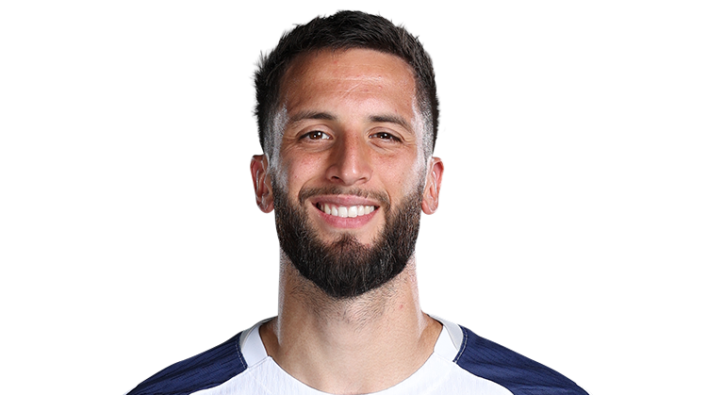
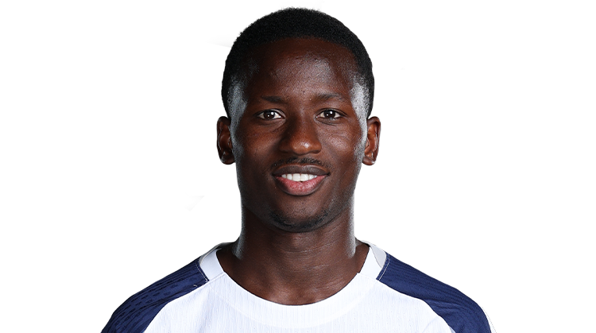


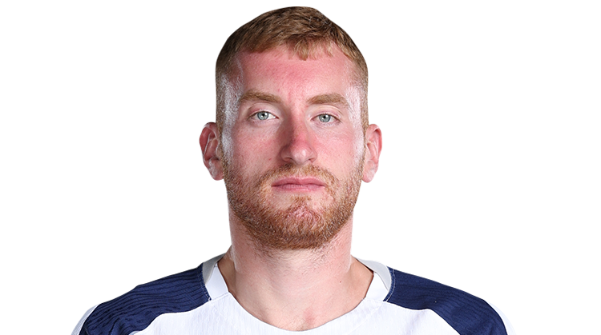


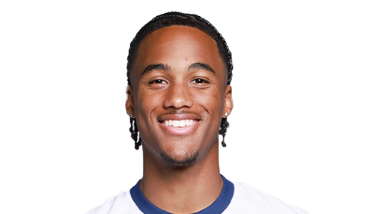
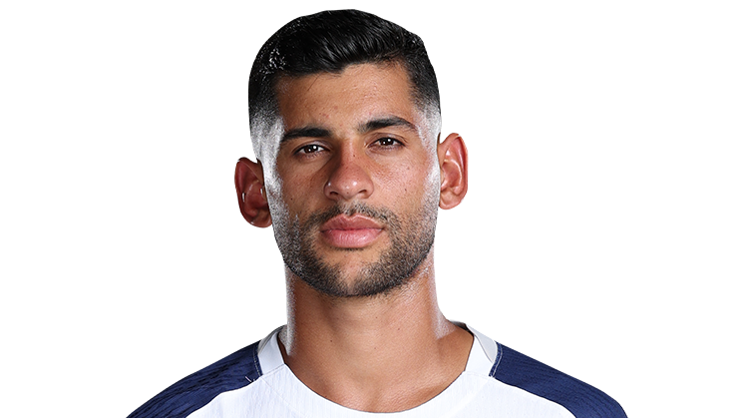



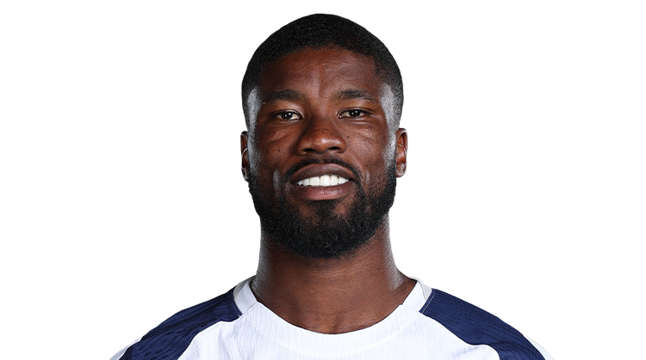

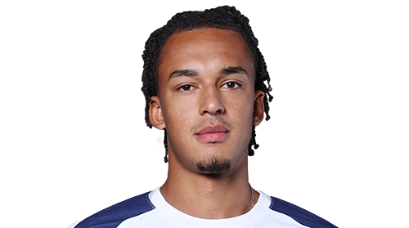
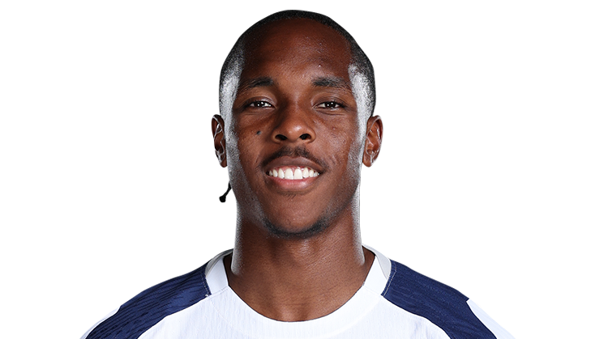
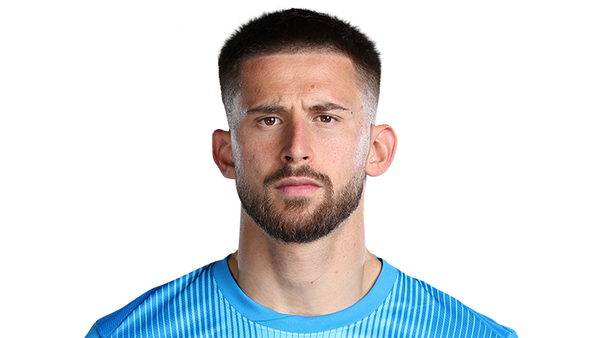
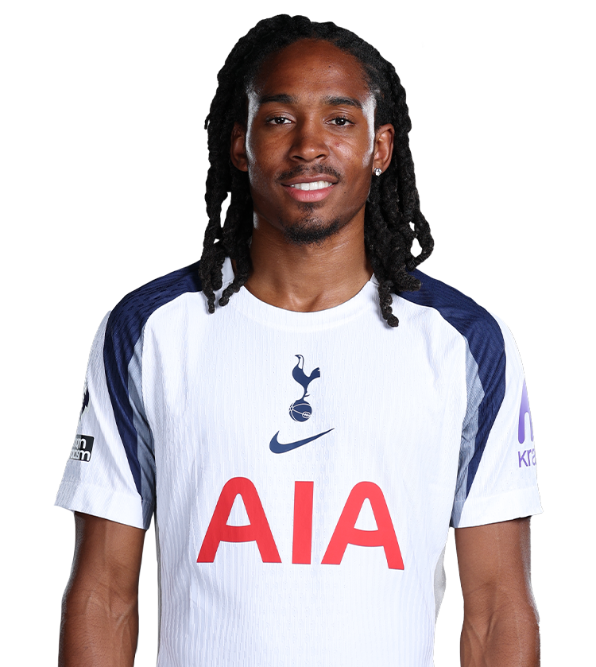

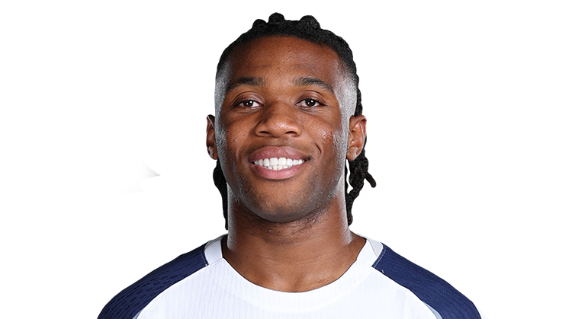
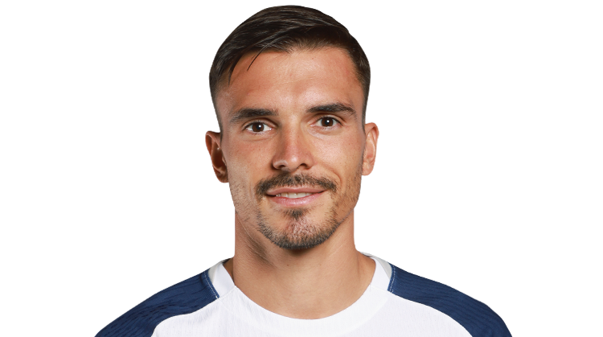
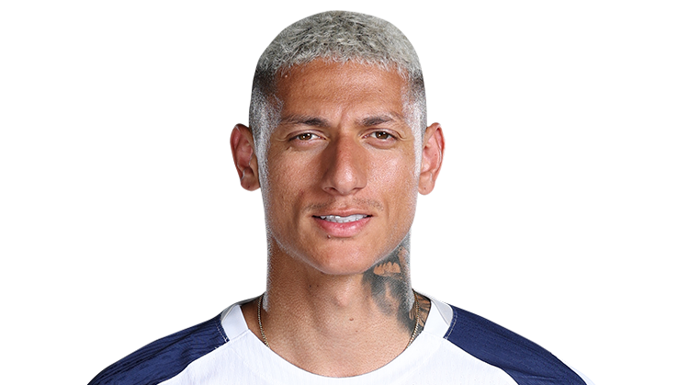
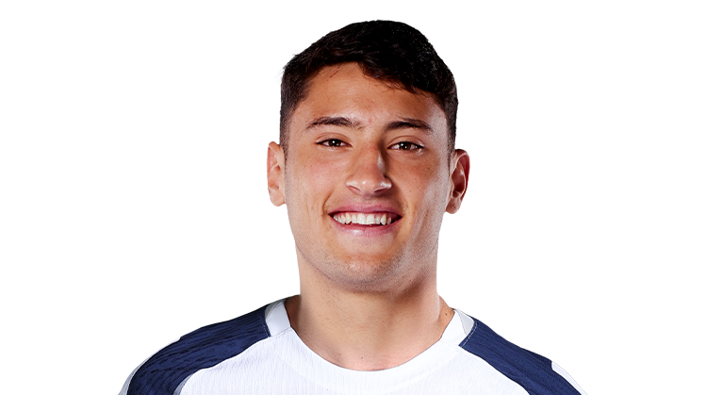
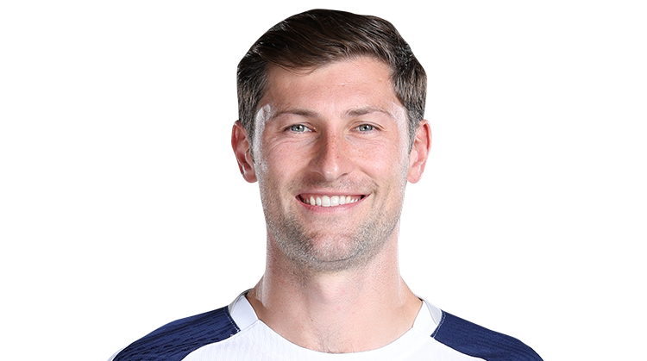
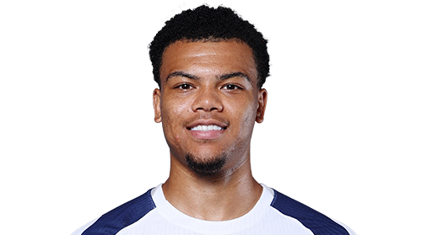
BERGVALL
BENTANCUR
SARR
VAN DE VEN
SIMONS
KOLO MUANI
ODOBERT
ROMERO
KUDUS
GRAY
DANSO
TEL
VICARIO
SPENCE
UDOGIE
PALHINHA
RICHARLISON

Slide 4
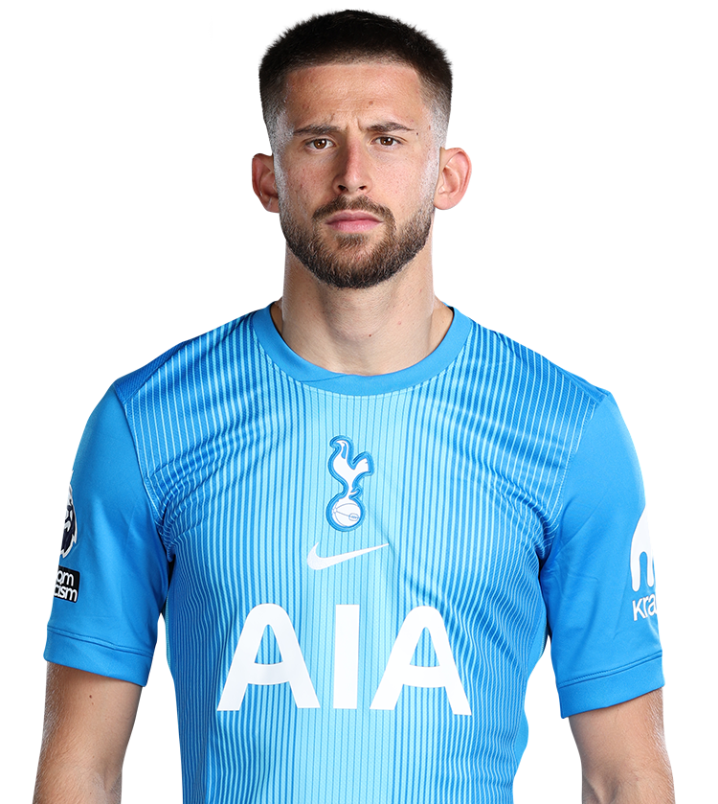
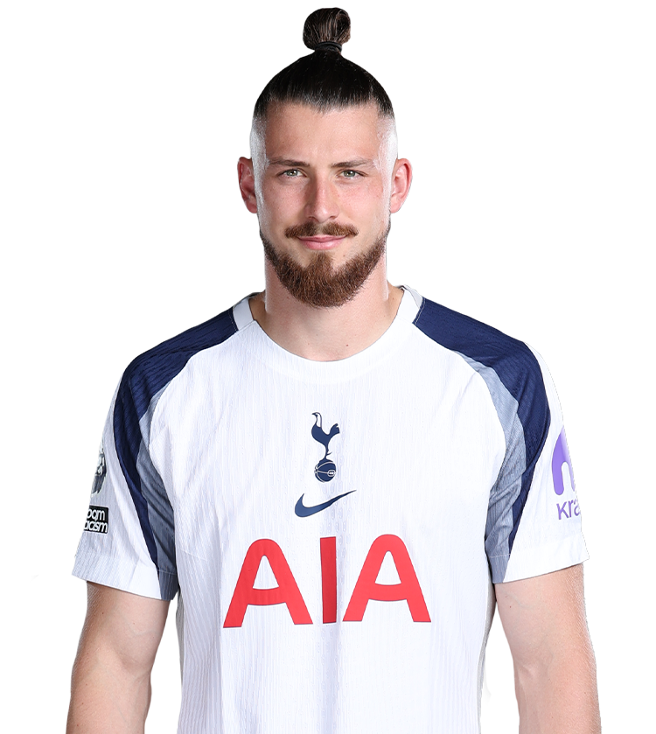
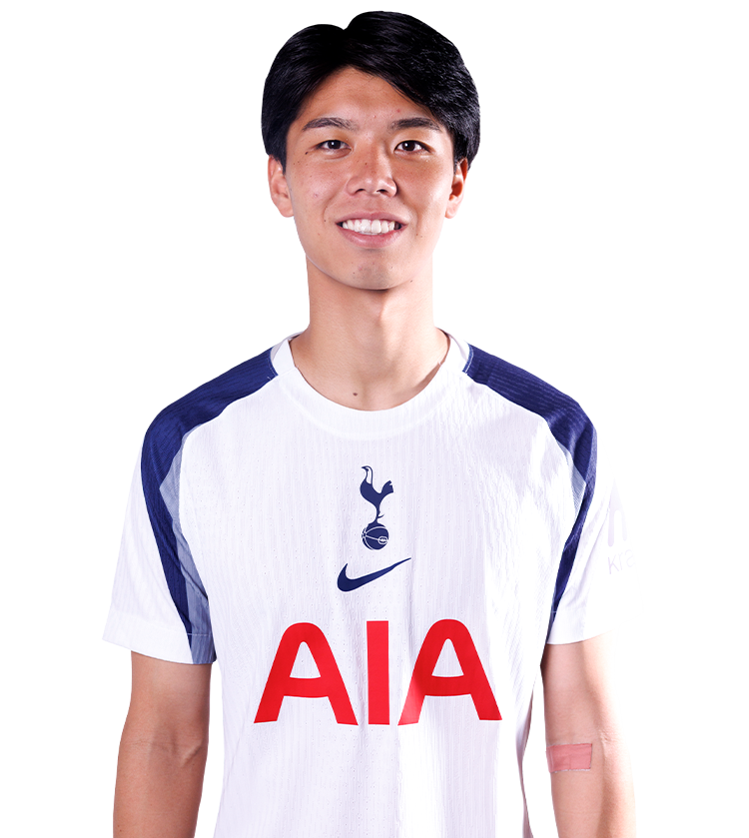
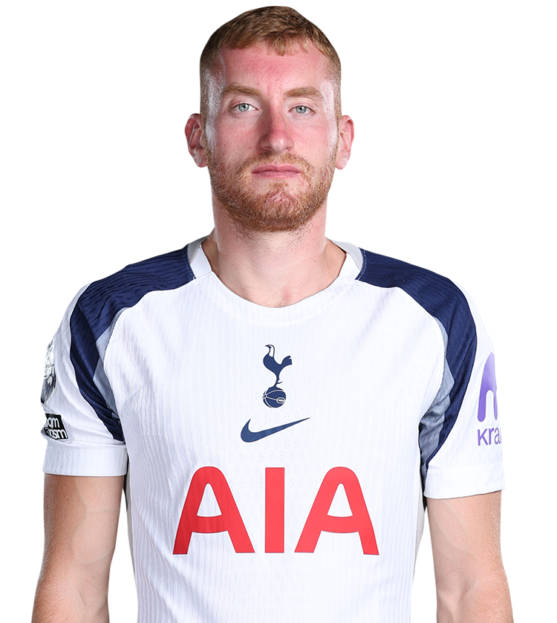
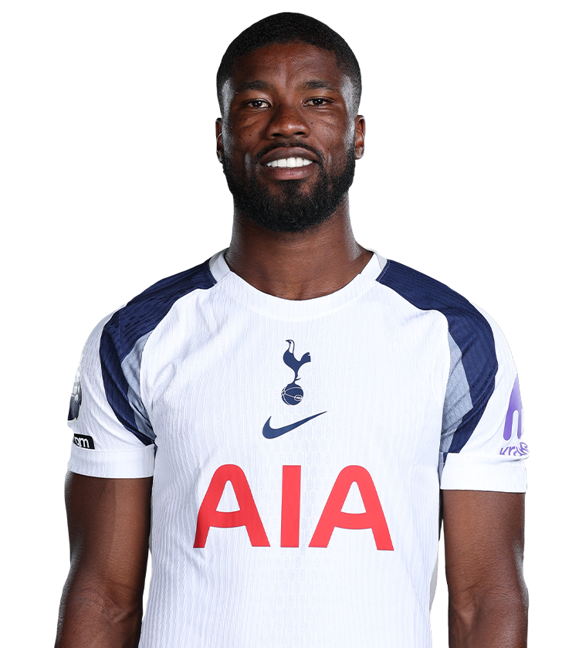
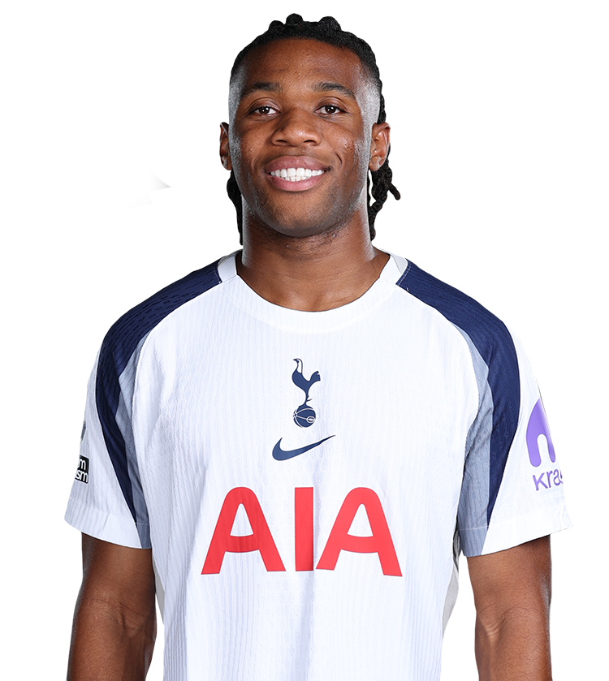
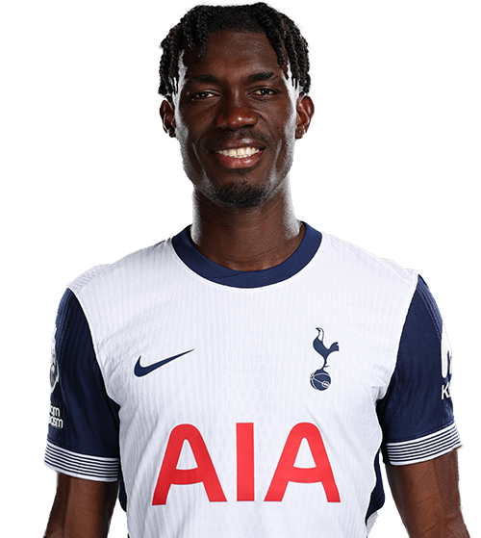
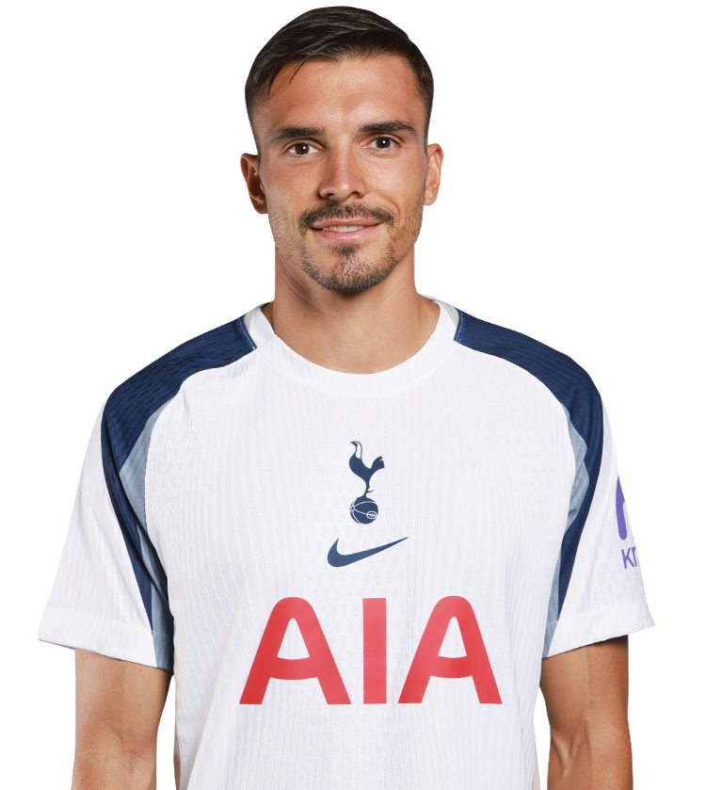
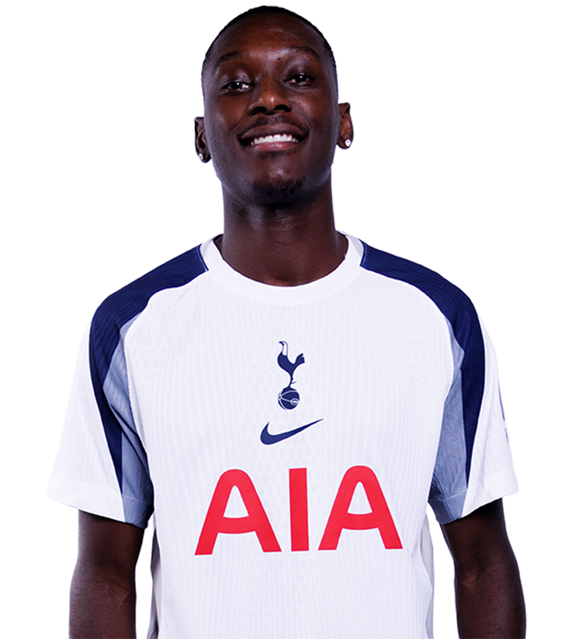
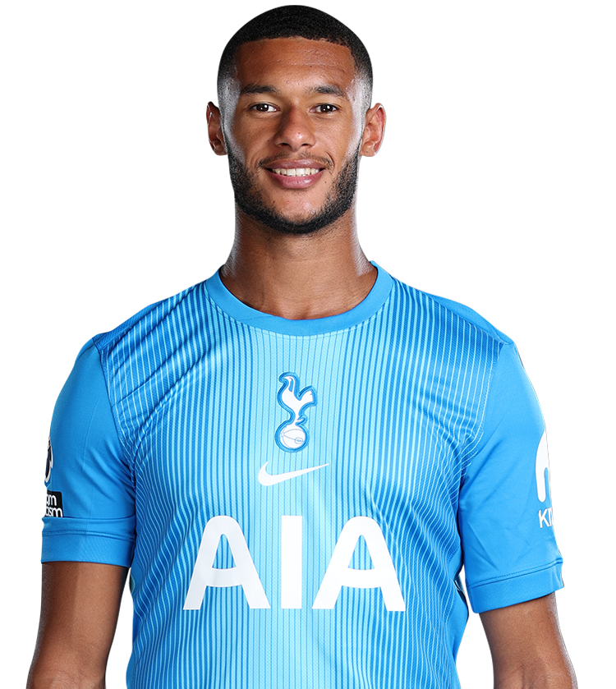
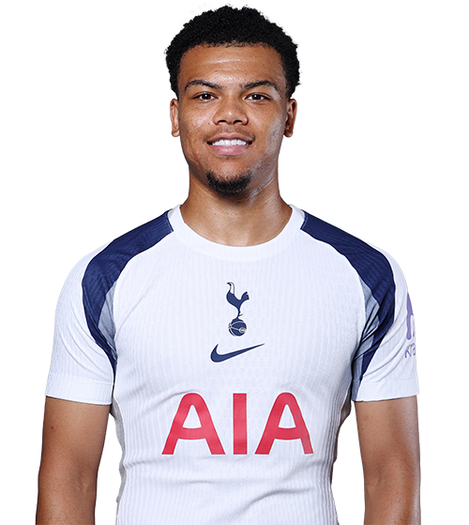
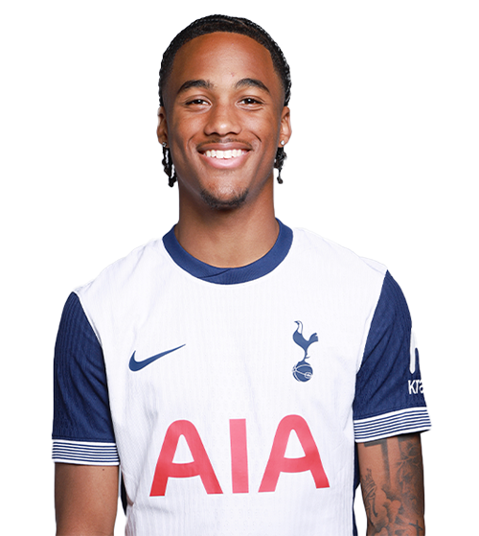
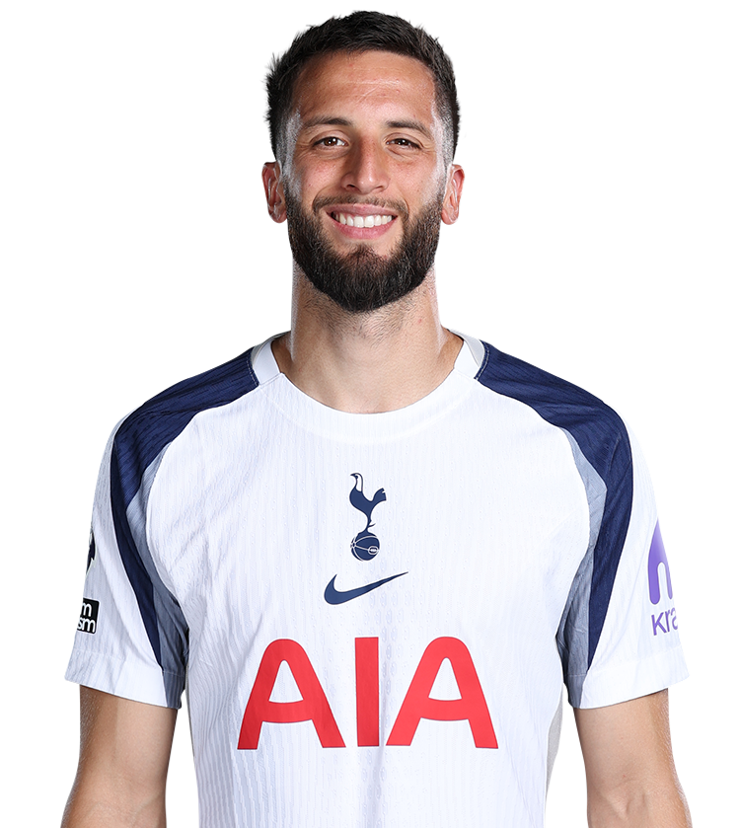
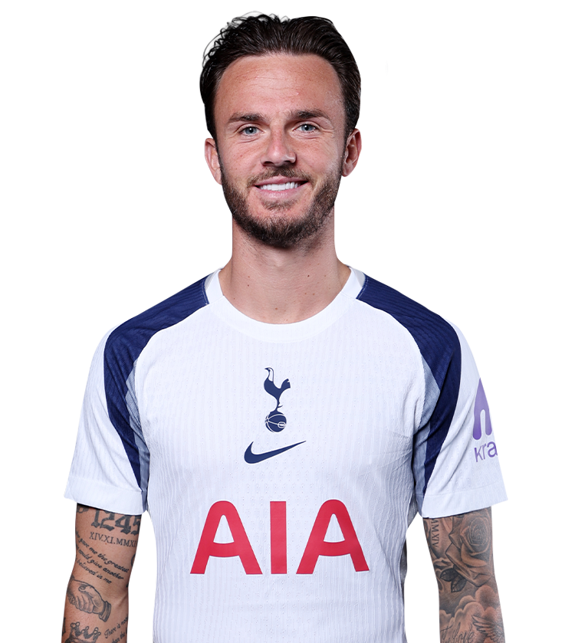
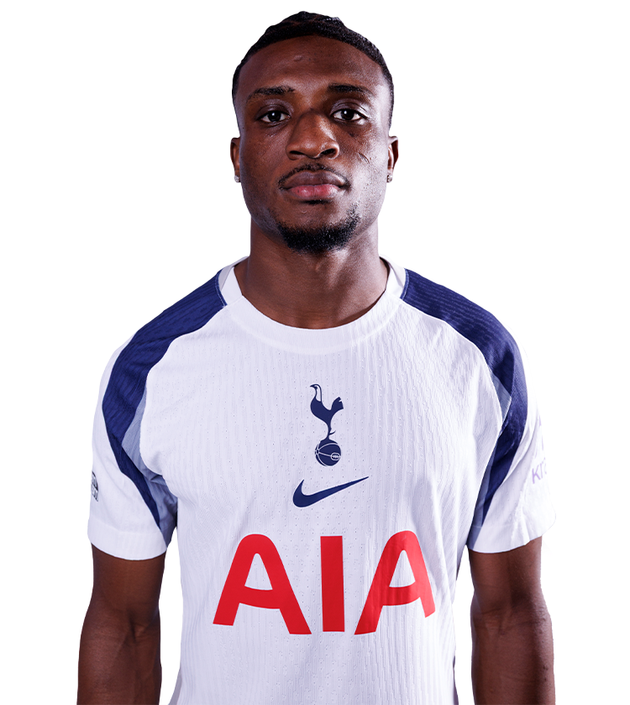
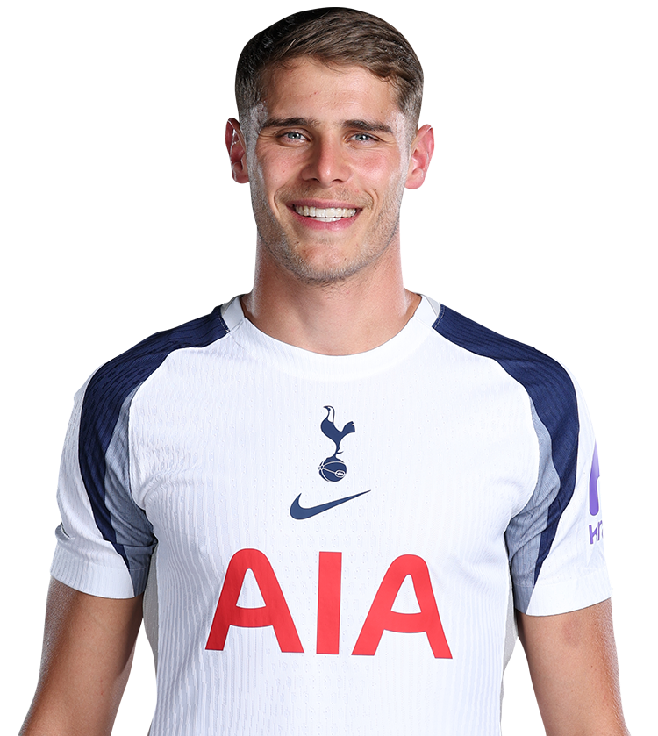
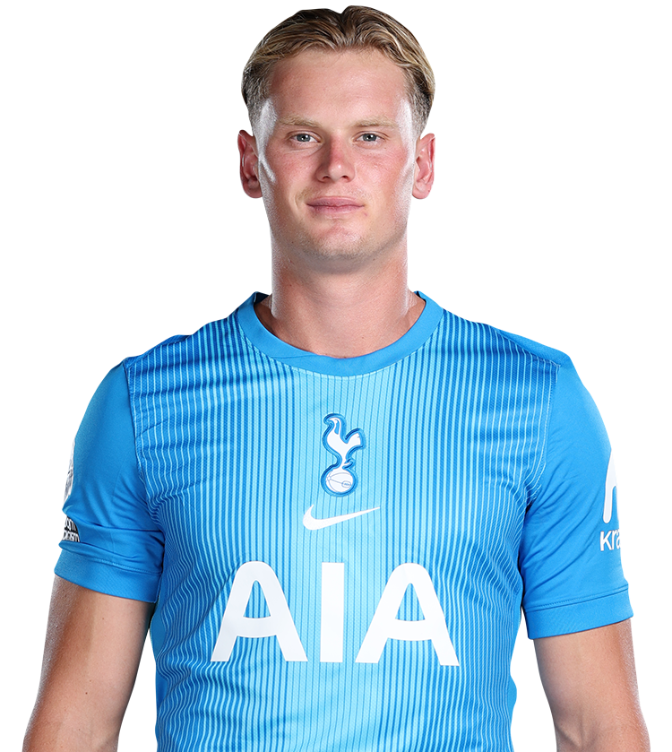
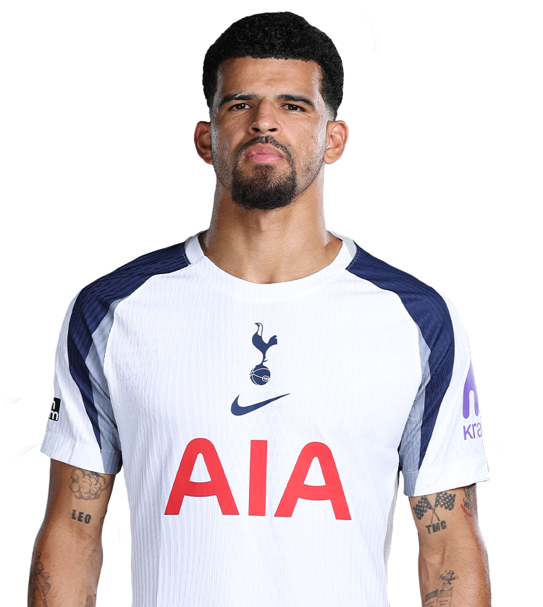
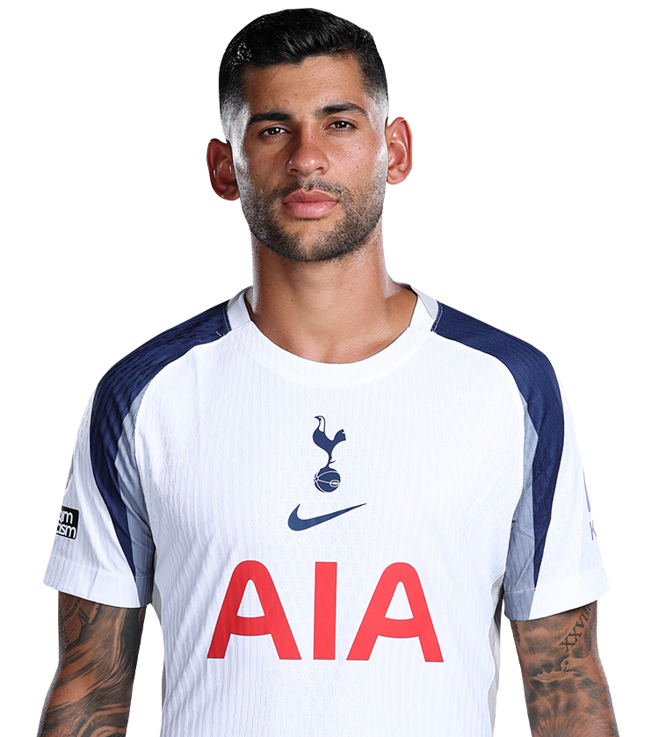
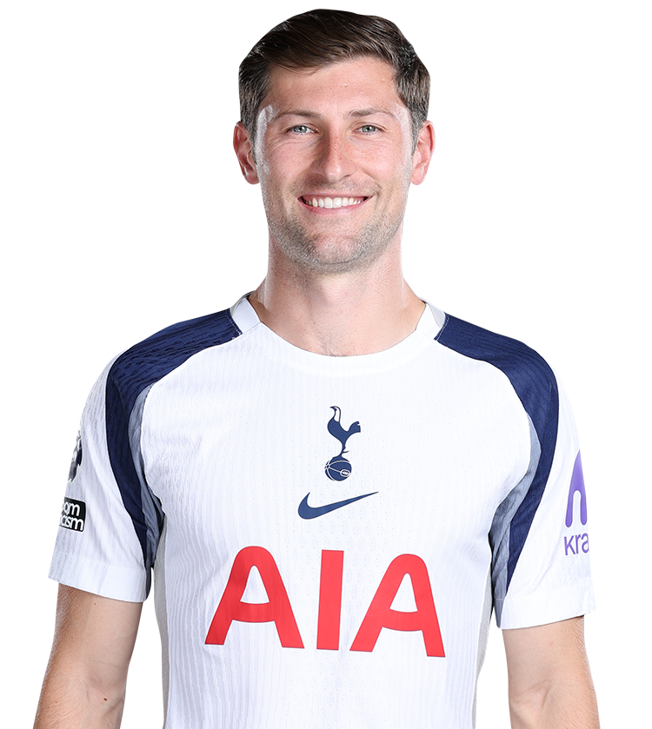
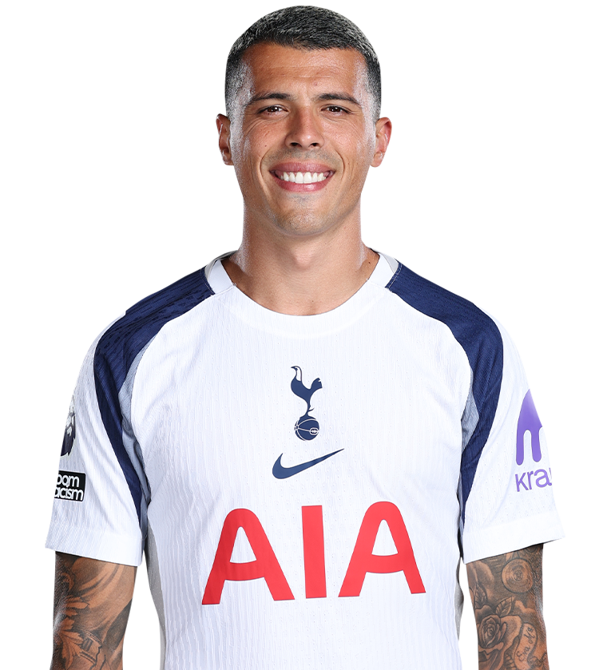
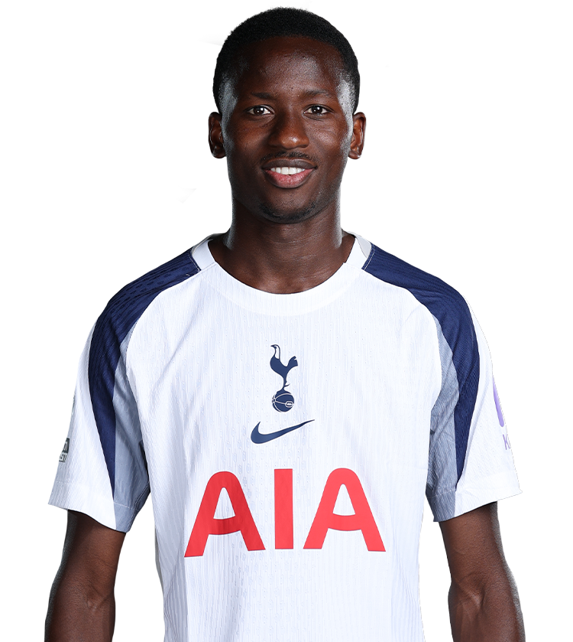
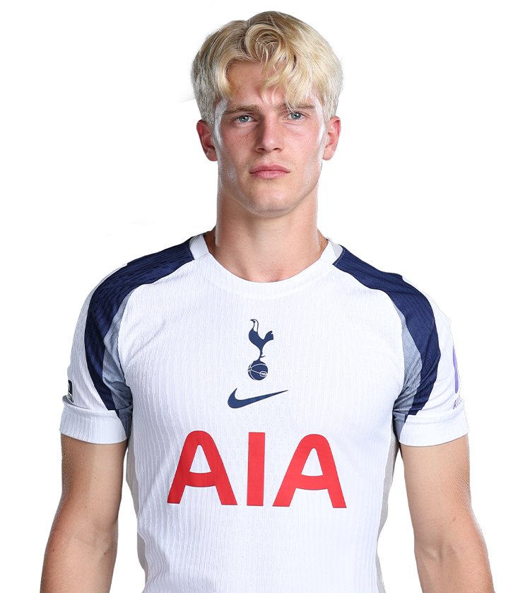
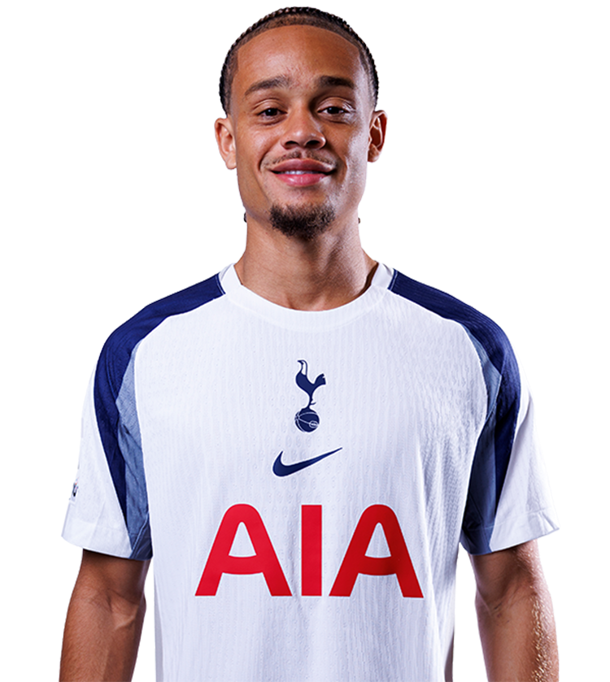
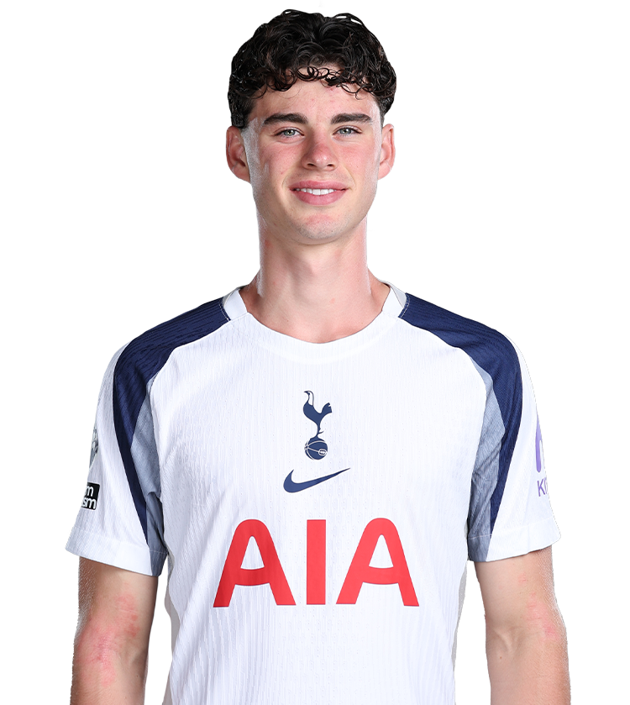
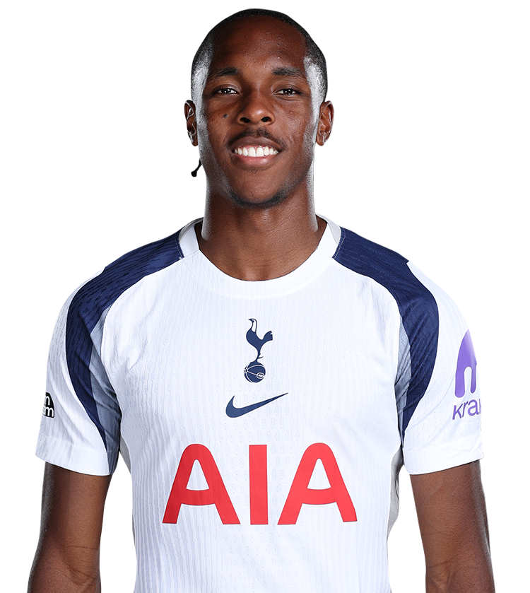
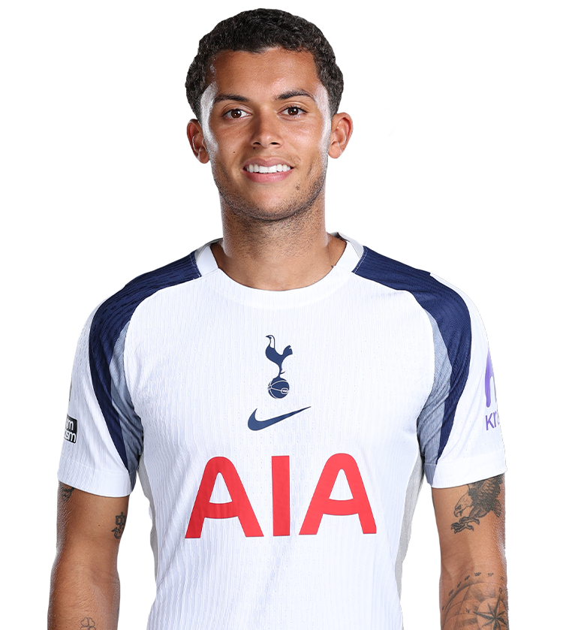
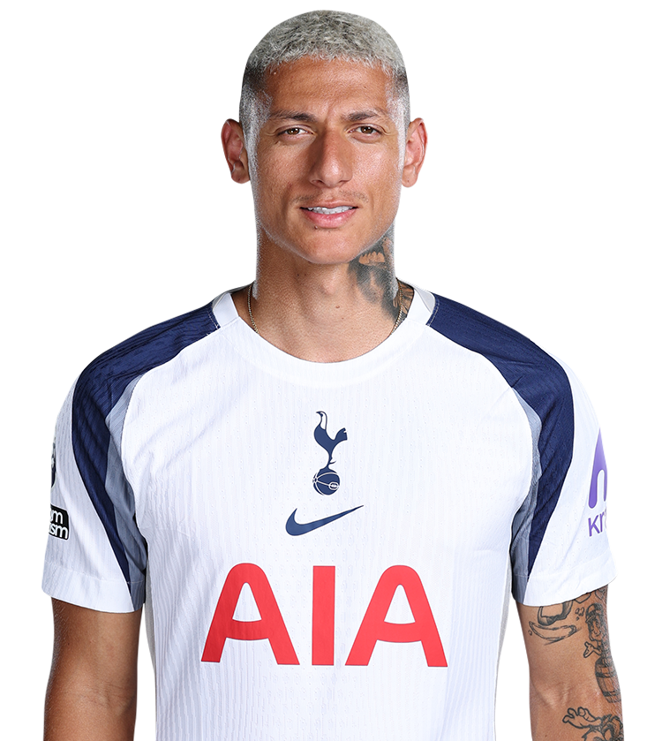

Slide 5
UEFA SUPER CUP FINAL – 13/8/25
Tottenham Rating |  | 7.4
PSG Rating |  | 5.8
Frank | Overall Rating | 7.4
 | Starting 11 | 8.7
 | Tactics | 8.2
 | Use of Subs | 3.8
Referee Rating |  | 6.5

Slide 6


 | r/coys | Ali Gold
Guglielmo Vicario | 5.8 | 6
Pedro Porro | 7.4 | 8
Kevin Danso | 7.5 | 7
Cristian Romero | 8.3 | 8
Micky Van de Ven | 8.0 | 8
Djed Spence | 8.3 | 7
João Paulinha | 7.6 | 7
Pape Matar Sarr | 8.1 | 8
Rodrigo Bentancur | 7.6 | 8
Mohammed Kudus | 8.5 | 7
Richarlison | 7.7 | 8
Dominic Solanke (72’) | 5.0 | 5
Archie Gray (72’) | 4.3 | 5
Mathys Tel (79’) | 2.1 | 4
Lucas Bergvall (90’) | 5.0 | N/A

Slide 7
PL Week 1 – Burnley – 16/8/25
Tottenham Rating |  | 8.1
Burnley Rating |  | 4.5
Frank | Overall Rating | 8.4
 | Starting 11 | 8.3
 | Tactics | 8.4
 | Use of Subs | 8.1
Referee Rating |  | 7.1

Slide 8
 | r/coys | Ali Gold
Guglielmo Vicario | 7.0 | 6
Pedro Porro | 7.4 | 7
Cristian Romero | 6.5 | 7
Micky Van de Ven | 7.6 | 8
Djed Spence | 7.4 | 8
Archie Gray | 6.5 | 7
Pape Matar Sarr | 7.9 | 8
Lucas Bergvall | 7.5 | 7
Brennan Johnson | 7.3 | 7
Mohammed Kudus | 9.4 | 8
Richarlison | 9.7 | 9
Dominic Solanke (72’) | 6.8 | 7
Rodrigo Bentancur (72’) | 6.6 | 6
Joao Palhinha (80’) | 6.5 | 6
Wilson Odobert (80’) | 6.1 | 5
Mathys Tel (85’) | 6.3 | N/A

Slide 9
PL Week 2 – Man City – 23/8/25
Tottenham Rating |  | 8.8
Manchester City Rating |  | 4.6
Frank | Overall Rating | 9.4
 | Starting 11 | 9.3
 | Tactics | 9.4
 | Use of Subs | 8.4
Referee Rating |  | 3.0

Slide 10
 | r/coys | Ali Gold
Guglielmo Vicario | 7.7 | 8
Pedro Porro | 7.8 | 9
Cristian Romero | 8.2 | 9
Micky Van de Ven | 8.3 | 8
Djed Spence | 8.3 | 8
Joao Palhinha | 9.1 | 9
Pape Matar Sarr | 9.0 | 9
Rodrigo Bentancur | 8.2 | 8
Brennan Johnson | 7.5 | 8
Mohammed Kudus | 8.1 | 8
Richarlison | 8.3 | 8
Dominic Solanke (77’) | 6.8 | 7
Wilson Odobert (77’) | 6.9 | 7
Lucas Bergvall (86’) | 6.9 | 7
Kevin Danso (91’) | 6.5 | N/a

Slide 11
PL Week 4 – West Ham – 13/9/25
Tottenham Rating |  | 8.0
West Ham Rating |  | 3.3
Frank | Overall Rating | 8.2
 | Starting 11 | 8.1
 | Tactics | 8.1
 | Use of Subs | 8.1
Referee Rating |  | 2.4

Slide 12
 | r/coys | Ali Gold
Guglielmo Vicario | 7.5 | 7
Pedro Porro | 7.0 | 7
Cristian Romero | 8.6 | 9
Micky Van de Ven | 8.8 | 9
Djed Spence | 7.6 | 7
Joao Palhinha | 7.8 | 7
Pape Matar Sarr | 8.4 | 8
Lucas Bergvall | 9.3 | 8
Xavi Simons | 7.4 | 7
Mohammed Kudus | 7.7 | 8
Mathys Tel | 6.1 | 5
Destiny Udogie (71’) | 6.5 | 6
Richarlison (71') | 6.1 | 6
Kevin Danso (79') | 6.3 | N/a
Wilson Odobert (79') | 6.2 | N/a
Brennan Johnson (79') | 6.1 | N/a

Slide 13
CL Group Stage – Villareal – 16/9/25
Tottenham Rating |  | 5.6
Villareal Rating |  | 4.7
Frank | Overall Rating | 6.3
 | Starting 11 | 7.2
 | Tactics | 6.2
 | Use of Subs | 6.3
Referee Rating |  | 2.2

Slide 14
 | r/coys | Ali Gold
Guglielmo Vicario | 7.1 | 6
Pedro Porro | 6.8 | 7
Cristian Romero | 6.7 | 7
Micky Van de Ven | 7.3 | 7
Djed Spence | 5.7 | 5
Rodrigo Bentancur | 6.4 | 6
Pape Matar Sarr | 6.1 | 5
Lucas Bergvall | 7.5 | 7
Xavi Simons | 6.1 | 6
Mohammed Kudus | 6.7 | 6
Richarlison | 5.3 | 5
Palhinha (69') | 6.9 | 6
Destiny Udogie (69') | 6.4 | 5
Randal Kolo Muani (77') | 5.3 | N/a
Brennan Johnson (77') | 5.1 | N/a
Kevin Danso (90+2') | 5.9 | N/a

Slide 15
PL Week 5 – Brighton – 20/9/25
Tottenham Rating |  | 6.5
Brighton Rating |  | 6.0
Frank | Overall Rating | 6.7
 | Starting 11 | 6.4
 | Tactics | 6.8
 | Use of Subs | 6.9
Referee Rating |  | 3.6

Slide 16
 | r/coys | Ali Gold
Guglielmo Vicario | 3.9 | 5
Pedro Porro | 5.8 | 6
Cristian Romero | 6.7 | 7
Micky Van de Ven | 6.3 | 7
Destiny Udogie | 8.0 | 8
Joao Palhinha | 6.7 | 7
Rodrigo Bentancur | 6.0 | 6
Lucas Bergvall | 6.3 | 7
Wilson Odobert | 5.6 | 4
Mohammed Kudus | 7.5 | 7
Richarlison | 6.3 | 7
Xavi Simons (61') | 7.3 | 7
Brennan Johnson (72') | 3.9 | 4
Djed Spence (89') | 5.7 | N/a
Archie Gray (89') | 5.9 | N/a

Slide 17
PL Week 6 – Wolves – 27/9/25
Tottenham Rating |  | 3.5
Wolves Rating |  | 5.5
Frank | Overall Rating | 4.2
 | Starting 11 | 4.7
 | Tactics | 4.1
 | Use of Subs | 4.6
Referee Rating |  | 4.4

Slide 18
 | r/coys | Ali Gold
Guglielmo Vicario | 4.3 | 6
Djed Spence | 4.8 | 6
Cristian Romero | 5.9 | 7
Micky Van de Ven | 6.1 | 7
Destiny Udogie | 5.8 | 6
Joao Palhinha | 7.4 | 8
Rodrigo Bentancur | 4.5 | 5
Lucas Bergvall | 5.2 | 7
Xavi Simons | 3.9 | 4
Mohammed Kudus | 5.8 | 6
Richarlison | 3.8 | 4
Brennan Johnson (63’) | 3.2 | 5
Pedro Porro (63’) | 4.6 | 5
Pape Matar Star (78’) | 5.3 | 6
Wilson Odobert (78’) | 4.3 | N/a
Mathys Tel (84’) | 4.5 | N/a

Slide 19
PL Week 8 – Aston Villa – 19/10/25
Tottenham Rating |  | 3.8
Aston Villa Rating |  | 5.2
Frank | Overall Rating | 3.7
 | Starting 11 | 4.3
 | Tactics | 3.6
 | Use of Subs | 3.4
Referee Rating |  | 4.5

Slide 20
PL Week 8 – Aston Villa – 19/10/25
Tottenham |  | 3.8
Aston Villa |  | 5.2
Frank | Overall | 3.7
 | Starting 11 | 4.3
 | Tactics | 3.6
 | Subs | 3.4
Referee |  | 4.5
Guglielmo Vicario | 3.8
Djed Spence | 5.2
Kevin Danso | 5.9
Micky Van de Ven | 5.8
Pedro Porro | 5.3
Joao Palhinha | 6.2
Rodrigo Bentancur | 4.9
Xavi Simons | 3.9
Wilson Odobert | 4.6
Mohammed Kudus | 5.9
Mathys Tel | 3.7
Richarlison (60’) | 3.3
Lucas Bergvall (79’) | 4.5
Randall Kolo Muani (79’) | 3.6
Pape Matar Sarr (86’) | 3.8
Brennan Johnson (86’) | 3.5

Slide 21
PL Week 9 – Everton – 26/10/25
Tottenham |  | 7.2
Everton |  | 5.1
Frank | Overall | 7.2
 | Starting 11 | 7.0
 | Tactics | 7.1
 | Subs | 7.4
Referee |  | 6.9
Guglielmo Vicario | 8.6
Pedro Porro | 7.3
Kevin Danso | 8.2
Micky Van de Ven | 9.7
Djed Spence | 6.6
Joao Palhinha | 7.2
Rodrigo Bentancur | 7.4
Xavi Simons | 5.2
Brennan Johnson | 5.6
Mohammed Kudus | 6.7
Randall Kolo Muani | 6.1
Lucas Bergvall (61’) | 6.4
Richarlison (62’) | 6.6
Pape Sarr (78’) | 7.6
Mathys Tel (90+3’) | 5.9

Slide 22
CL Group Stage – Monaco – 22/10/25
Tottenham |  | 2.5
Monaco |  | 6.1
Frank | Overall | 3.0
 | Starting 11 | 3.7
 | Tactics | 2.6
 | Subs | 4.4
Referee |  | 6.2
Guglielmo Vicario | 9.5
Pedro Porro | 3.8
Kevin Danso | 5.3
Micky Van de Ven | 5.6
Archie Gray | 5.5
Joao Palhinha | 5.3
Rodrigo Bentancur | 3.8
Lucas Bergvall | 3.9
Wilson Odobert | 4.8
Mohammed Kudus | 5.3
Richarlison | 2.8
Xavi Simons (60’) | 3.2
Pape Matar Sarr (60’) | 4.2
Randall Kolo Muani (70’) | 5.2
Brennan Johnson (70’) | 3.6
Djed Spence (79’) | 4.4

Slide 23
CL Group Stage – Copenhagen – 4/11/25
Tottenham |  | 8.8
Copenhagen |  | 2.7
Frank | Overall | 8.1
 | Starting 11 | 8.7
 | Tactics | 8.4
 | Subs | 8.1
Referee |  | 5.8
Guglielmo Vicario | 7.5
Pedro Porro | 7.9
Cristian Romero | 8.1
Micky Van de Ven | 9.6
Destiny Udogie | 8.1
Rodrigo Bentancur | 8.1
Pape Matar Sarr | 7.3
Xavi Simons | 8.5
Brennan Johnson | 6.7
Wilson Odobert | 7.6
Randal Kolo Muani | 7.4
Joao Palhinha (61') | 8.0
Richarlison (73') | 3.9
Djed Spence (73') | 6.4
Kavin Danso (73’) | 6.6
Dane Scarlett (80’) | 7.6

Slide 24
League Cup – Newcastle – 29/10/25
Tottenham |  | 4.3
Newcastle |  | 6.1
Frank | Overall | 4.8
 | Starting 11 | 5.0
 | Tactics | 4.6
 | Subs | 5.2
Referee |  | 1.8
Antonin Kinsky | 3.4
Pedro Porro | 5.4
Kevin Danso | 5.7
Joao Palhinha | 6.0
Djed Spence | 5.9
Rodrigo Bentancur | 5.1
Pape Matar Sarr | 5.2
Lucas Bergvall | 5.8
Xavi Simons | 4.5
Brennan Johnson | 3.8
Richarlison | 2.9
Mohammed Kudus (65') | 4.9
Randal Kolo Muani (65') | 5.4
Mathys Tel (78’) | 4.6

Slide 25
PL Week 10 – Chelsea – 1/11/25
Guglielmo Vicario | 8.0
Pedro Porro | 3.7
Kevin Danso | 4.0
Micky Van de Ven | 3.1
Djed Spence | 3.5
Joao Palhinha | 4.5
Rodrigo Bentancur | 3.4
Pape Matar Sarr | 3.3
Lucas Bergvall | 5.1
Mohammed Kudus | 4.2
Randal Kolo Muani | 4.2
Xavi Simons (7’) | 1.6
Richarlison (60’) | 2.6
Cristian Romero (60’) | 5.7
Wilson Odobert (73’) | 3.7
Destiny Udogie (73’) | 4.0
Brennan Johnson (73’) | 3.3
Tottenham |  | 1.1
Chelsea |  | 5.8
Frank | Overall | 2.0
 | Starting 11 | 3.8
 | Tactics | 1.5
 | Subs | 3.1
Referee |  | 4.0

Slide 26
PL Week 11 – Man U – 8/11/25
Guglielmo Vicario | 4.3
Pedro Porro | 3.8
Cristian Romero | 5.9
Micky Van de Ven | 6.8
Djed Spence | 5.2
Joao Palhinha | 5.7
Pape Matar Sarr | 4.6
Xavi Simons | 6.1
Brennan Johnson | 4.0
Richarlison | 4.0
Randal Kolo Muani | 4.7
Wilson Odobert (46’) | 7.7
Destiny Udogie (67’) | 7.2
Rodrigo Bentancur (79’) | 5.5
Mathys Tel (79’) | 7.6
Kevin Danso (88’) | 5.6
Tottenham |  | 4.8
Man U |  | 4.9
Frank | Overall | 4.7
 | Starting 11 | 4.3
 | Tactics | 4.3
 | Subs | 6.3
Referee |  | 5.5

Slide 27
PL Week 12 – Arsenal – 23/11/25
Guglielmo Vicario | 4.4
Djed Spence | 3.0
Kevin Danso | 2.8
Cristian Romero | 3.3
Micky Van de Ven | 3.1
Destiny Udogie | 3.2
Joao Palhinha | 3.8
Rodrigo Bentancur | 2.0
Mohammed Kudus | 3.0
Wilson Odobert | 2.2
Richarlison | 4.1
Xavi Simons (46') | 4.0
Pape Matar Sarr (66') | 3.2
Randal Kolo Muani (66') | 3.2
Pedro Porro (78') | 3.4
Brennan Johnson (78') | 2.8
Tottenham |  | 0.9
Arsenal |  | 7.6
Frank | Overall | 1.1
 | Starting 11 | 1.9
 | Tactics | 0.9
 | Subs | 3.2
Referee |  | 3.7

Slide 28
CL Group Stage – PSG – 26/11/25
Guglielmo Vicario | 4.9
Pedro Porro | 5.3
Cristian Romero | 3.2
Micky Van de Ven | 5.0
Djed Spence | 5.0
Rodrigo Bentancur | 4.7
Archie Gray | 6.7
Lucas Bergvall | 7.0
Pape Matar Sarr | 4.9
Randal Kolo Muani | 8.6
Richarlison | 6.9
Joao Palhinha (76’) | 4.9
Mohammed Kudus (76’) | 4.9
Destiny Udogie (84’) | 5.2
Xavi Simons (84’) | 5.6
Wilson Odobert (84’) | 5.1
Tottenham |  | 6.0
PSG |  | 7.1
Frank | Overall | 6.0
 | Starting 11 | 7.2
 | Tactics | 6.7
 | Subs | 4.0
Referee |  | 5.6

Slide 29
PL Week 13 – Fulham – 29/11/25
Tottenham |  | 1.9
Fulham |  | 5.1
Frank | Overall | 1.7
 | Starting 11 | 3.7
 | Tactics | 1.5
 | Subs | 2.9
Referee |  | 2.7
Guglielmo Vicario | 1.0
Pedro Porro | 2.4
Kevin Danso | 3.7
Micky Van de Ven | 5.9
Destiny Udogie | 2.9
Joao Palhinha | 3.1
Archie Gray | 3.9
Lucas Bergvall | 5.6
Mohammed Kudus | 6.1
Randal Kolo Muani | 6.2
Richarlison | 3.1
Xavi Simons (60’) | 3.3
Rodrigo Bentancur (60’) | 2.7
Wilson Odobert (60’) | 3.6
Pape Matar Sarr (77’) | 3.6
Mathys Tel (85’) | 3.9

Slide 30
PL Week 14 – Newcastle – 2/12/2025
Tottenham |  | 4.3
Newcastle |  | 5.3
Frank | Overall | 3.6
 | Starting 11 | 4.5
 | Tactics | 3.2
 | Subs | 3.9
Referee |  | 0.8
Guglielmo Vicario | 6.0
Pedro Porro | 4.7
Cristian Romero | 9.1
Kevin Danso | 6.3
Destiny Udogie | 5.1
Rodrigo Bentancur | 3.4
Pape Matar Sarr | 4.1
Lucas Bergvall | 6.3
Brennan Johnson | 4.6
Mohammed Kudus | 5.5
Randal Kolo Muani | 6.2
Xavi Simons (77’) | 5.4
Mathys Tel (77') | 5.6
Richarlison (77') | 4.4
Wilson Odobert (88') | 5.0
Archie Gray (88') | 5.1

Slide 31
PL Week 15 – Brentford – 6/12/2025
Tottenham |  | 8.1
Brentford |  | 3.5
Frank | Overall | 7.4
 | Starting 11 | 8.2
 | Tactics | 7.9
 | Subs | 6.2
Referee |  | 5.1
Guglielmo Vicario | 6.8
Pedro Porro | 6.9
Cristian Romero | 7.2
Micky Van de Ven | 7.9
Djed Spence | 7.8
Rodrigo Bentancur | 7.1
Archie Gray | 7.7
Xavi Simons | 9.1
Mohammed Kudus | 7.9
Randal Kolo Muani | 7.2
Richarlison | 7.6
Joao Palhinha (65') | 6.6
Wilson Odobert (74’) | 5.7
Pape Matar Sarr (80') | 5.4
Kevin Danso (81') | 5.6

Slide 32
CL Group Stage – Slavia Prague – 9/12/2025
Tottenham |  | 7.5
Slavia Prague |  | 3.6
Frank | Overall | 7.3
 | Starting 11 | 7.9
 | Tactics | 7.3
 | Subs | 7.5
Referee |  | 5.4
Guglielmo Vicario | 7.3
Pedro Porro | 6.8
Cristian Romero | 7.2
Micky Van de Ven | 7.0
Djed Spence | 7.4
Joao Palhinha | 6.6
Archie Gray | 7.3
Xavi Simons | 8.6
Mohammed Kudus | 7.8
Wilson Odobert | 6.9
Richarlison | 6.7
Mathys Tel (58') | 6.9
Pape Matar Sarr (58') | 6.2
Randal Kolo Muani (68') | 6.8
Ben Davies (68') | 6.6
Lucas Bergvall (76') | 6.5

Slide 33
PL Week 16 – Nottingham Forest – 14/12/2025
Tottenham |  | 0.9
Nottingham Forest |  | 6.8
Frank | Overall | 1.0
 | Starting 11 | 4.0
 | Tactics | 0.9
 | Subs | 0.9
Referee |  | 4.3
Guglielmo Vicario | 1.4
Pedro Porro | 2.3
Cristian Romero | 3.4
Micky Van de Ven | 3.7
Djed Spence | 3.0
Rodrigo Bentancur | 2.6
Archie Gray | 2.6
Xavi Simons | 3.1
Mohammed Kudus | 2.5
Randal Kolo Muani | 3.9
Richarlison | 1.5
Lucas Bergvall (59’) | 3.5
Joao Palhinha (59’) | 3.3
Ben Davies (59’) | 3.2
Brennan Johnson (80’) | 2.9
Mathys Tel (80’) | 3.6

Slide 34
PL Week 17 – Liverpool – 20/12/2025
Tottenham |  | 4.9
Liverpool |  | 3.9
Frank | Overall | 4.3
 | Starting 11 | 6.1
 | Tactics | 4.5
 | Subs | 5.3
Referee |  | 0.3
Guglielmo Vicario | 4.4
Pedro Porro | 5.2
Cristian Romero | 2.6
Micky Van de Ven | 5.5
Djed Spence | 7.1
Rodrigo Bentancur | 5.2
Archie Gray | 5.5
Lucas Bergvall | 5.9
Xavi Simons | 1.7
Mohammed Kudus | 3.5
Randal Kolo Muani | 5.7
Brennan Johnson (58') | 5.4
Joao Palhinha (71’) | 5.4
Wilson Odobert (71') | 5.7
Richarlison (80’) | 7.7

Slide 35
PL Week 18 – Crystal Palace – 28/12/2025
Tottenham |  | 5.7
Crystal Palace |  | 4.9
Frank | Overall | 5.2
 | Starting 11 | 6.1
 | Tactics | 4.5
 | Subs | 6.7
Referee |  | 5.6
Guglielmo Vicario | 6.4
Pedro Porro | 5.7
Kevin Danso | 6.8
Micky Van de Ven | 6.7
Djed Spence | 6.4
Rodrigo Bentancur | 5.8
Archie Gray | 7.6
Lucas Bergvall | 6.1
Mohammed Kudus | 6.0
Randal Kolo Muani | 5.7
Richarlison | 7.1
Joao Palhinha (62’) | 6.7
Wilson Odobert (63’) | 8.0
Radu Dragusin (86’) | 6.7
Brennan Johnson (86’) | 5.9

Slide 36
PL Week 19 – Brentford – 1/1/2026
Tottenham |  | 2.1
Brentford |  | 3.4
Frank | Overall | 1.5
 | Starting 11 | 3.0
 | Tactics | 1.3
 | Subs | 2.3
Referee |  | 4.7
Guglielmo Vicario | 5.0
Pedro Porro | 3.9
Cristian Romero | 4.6
Micky Van de Ven | 6.0
Djed Spence | 4.5
Joao Palhinha | 4.1
Rodrigo Bentancur | 4.4
Archie Gray | 4.2
Mohammed Kudus | 3.7
Wilson Odobert | 4.4
Richarlison | 4.3
Randal Kolo Muani (67') | 4.0
Mathys Tel (80') | 4.2

Slide 37
PL Week 20 – Sunderland – 4/1/2026
Tottenham |  | 4.3
Sunderland |  | 4.9
Frank | Overall | 3.0
 | Starting 11 | 6.4
 | Tactics | 3.3
 | Subs | 2.5
Referee |  | 3.7
Guglielmo Vicario | 5.1
Pedro Porro | 5.9
Cristian Romero | 4.3
Micky Van de Ven | 6.0
Ben Davies | 7.4
Rodrigo Bentancur | 4.6
Archie Gray | 5.1
Mohammed Kudus | 4.2
Mathys Tel | 5.9
Wilson Odobert | 5.6
Richarlison | 5.0
Randal Kolo Muani (19’) | 3.7
Lucas Bergvall (72’) | 4.4
Joao Palhinha (72’) | 3.9
Djed Spence (87’) | 4.7
Dane Scarlett (87’) | 4.8

Slide 38
PL Week 21 – Bournemouth – 7/1/2026
Guglielmo Vicario | 3.0
Pedro Porro | 3.3
Cristian Romero | 4.9
Micky Van de Ven | 5.6
Djed Spence | 4.3
Joao Palhinha | 6.7
Rodrigo Bentancur | 3.5
Lucas Bergvall | 5.5
Xavi Simons | 5.7
Randal Kolo Muani | 2.8
Mathys Tel | 7.3
Wilson Odobert (57') | 5.3
Richarlison (67') | 5.3
Archie Gray (87') | 4.7
Tottenham |  | 3.8
Bournemouth |  | 5.5
Frank | Overall | 2.4
 | Starting 11 | 4.3
 | Tactics | 2.5
 | Subs | 3.5
Referee |  | 3.6

Slide 39
FA Cup – Aston Villa – 10/1/2026
Guglielmo Vicario | 4.4
Pedro Porro | 4.7
Kevin Danso | 5.1
Micky Van de Ven | 5.8
Ben Davies | 5.9
Joao Palhinha | 7.5
Archie Gray | 5.1
Xavi Simons | 7.8
Mathys Tel | 6.9
Wilson Odobert | 7.2
Richarlison | 4.6
Randal Kolo Muani (31’) | 4.8
Dane Scarlett (78’) | 4.6
Djed Spence (83’) | 3.7
Dominic Solanke (83’) | 4.9
Tottenham |  | 4.7
Aston Villa |  | 5.9
Frank | Overall | 2.4
 | Starting 11 | 5.5
 | Tactics | 2.3
 | Subs | 3.2
Referee |  | 1.7

Slide 40
PL Week 22 – West Ham – 17/1/2026
Guglielmo Vicario | 2.3
Pedro Porro | 4.1
Cristian Romero | 5.8
Micky Van de Ven | 5.8
Ben Davies | 5.0
Archie Gray | 4.9
Conor Gallagher | 4.4
Xavi Simons | 4.1
Mathys Tel | 4.9
Wilson Odobert | 3.8
Randal Kolo Muani | 2.0
Djed Spence (19') | 3.6
Yves Bissouma (46') | 5.6
Dominic Solanke (62') | 4.1
Lucas Bergvall (90') | 5.1
Tottenham |  | 1.9
West Ham |  | 4.6
Frank | Overall | 0.9
 | Starting 11 | 4.0
 | Tactics | 0.9
 | Subs | 1.7
Referee |  | 3.0

Slide 41
CL Group Stage – Dortmund – 20/1/2026
Guglielmo Vicario | 6.0
Pedro Porro | 6.9
Kevin Danso | 7.5
Cristian Romero | 8.4
Destiny Udogie | 7.6
Djed Spence | 8.1
Archie Gray | 7.1
Lucas Bergvall | 6.9
Xavi Simons | 8.6
Wilson Odobert | 8.3
Dominic Solanke | 7.7
Junai Byfield (62') | 6.7
Randal Kolo Muani (70') | 3.1
Tottenham |  | 7.7
Dortmund |  | 3.8
Frank | Overall | 6.0
 | Starting 11 | 7.2
 | Tactics | 6.3
 | Subs | 4.7
Referee |  | 5.7

Slide 42
PL Week 23 – Burnley – 24/1/2026
Guglielmo Vicario | 3.1
Pedro Porro | 3.9
Kevin Danso | 4.9
Cristian Romero | 6.6
Micky Van de Ven | 6.9
Djed Spence | 5.7
Yves Bissouma | 5.8
Conor Gallagher | 4.7
Xavi Simons | 4.9
Wilson Odobert | 6.3
Dominic Solanke | 5.0
Destiny Udogie (46') | 5.4
Archie Gray (78') | 4.8
Mathys Tel (78') | 5.1
Dane Scarlett (85') | 4.9
Radu Dragusin (90+5') | 4.7
Tottenham |  | 3.4
Burnley |  | 4.6
Frank | Overall | 1.7
 | Starting 11 | 3.6
 | Tactics | 1.7
 | Subs | 1.7
Referee |  | 5.2

Slide 43
PL Week 24 – Man City – 1/2/2026
Guglielmo Vicario | 5.3
Archie Gray | 6.7
Radu Dragusin | 4.9
Cristian Romero | 4.8
Destiny Udogie | 6.6
Joao Palhinha | 7.5
Yves Bissouma | 4.6
Conor Gallagher | 7.3
Xavi Simons | 8.7
Randal Kolo Muani | 4.8
Dominic Solanke | 9.2
Pape Matar Sarr (46') | 7.0
Mathys Tel (68') | 6.1
Wilson Odobert (68') | 6.5
Junai Byfield (90') | 6.1
Tottenham |  | 6.4
Man City |  | 5.2
Frank | Overall | 5.4
 | Starting 11 | 5.1
 | Tactics | 5.0
 | Subs | 7.2
Referee |  | 4.8

Slide 44

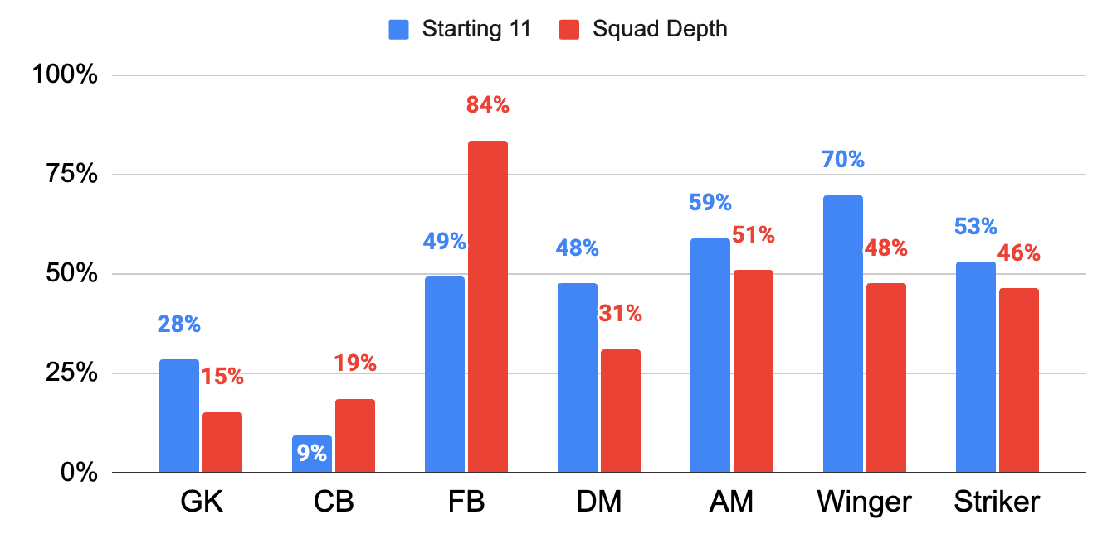
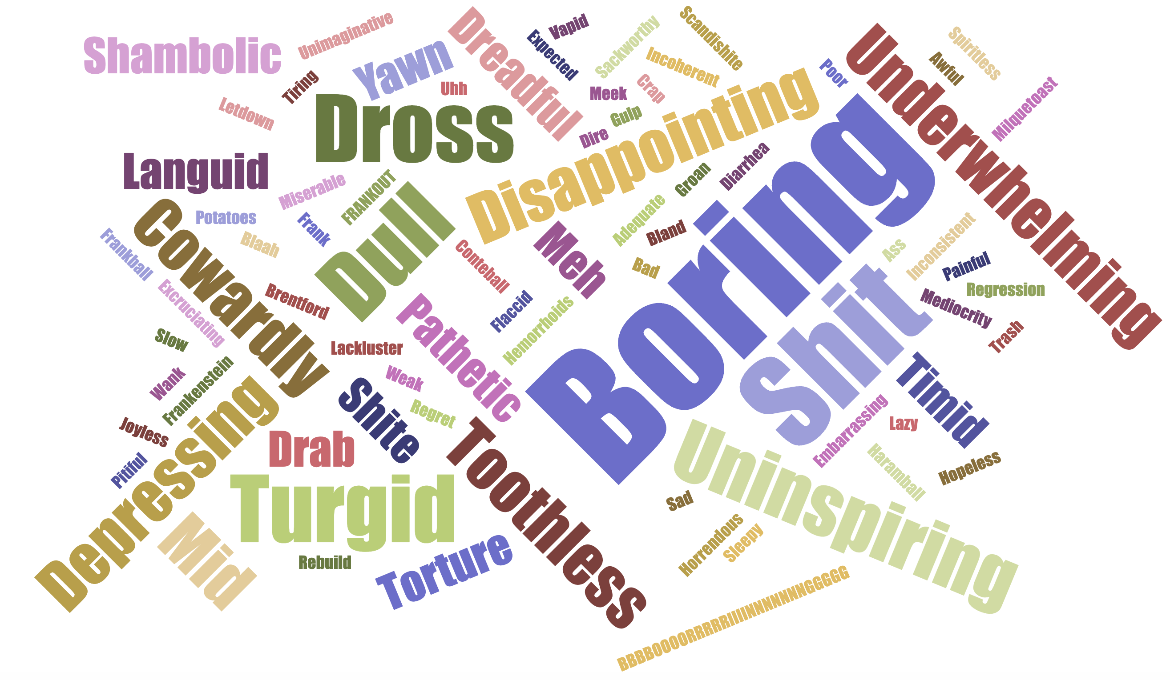
Mid-Season Check-In Results
What positions to improve on in January transfer window?
Team Rating
2.4
Manager Rating
1.8
Describe the first half of the season in one word.
Best Player
64%
Most Disappointing
41%

Slide 45
CL Group Stage – Bodo/Glimt – 30/9/25
Tottenham Rating |  | 2.6
Bodo/Glimt Rating |  | 7.3
Frank | Overall Rating | 3.3
 | Starting 11 | 3.2
 | Tactics | 2.7
 | Use of Subs | 5.5
Referee Rating |  | 4.0

Slide 46
 | r/coys | Ali Gold
Guglielmo Vicario | 4.3 | 5
Pedro Porro | 4.7 | 5
Kevin Danso | 4.1 | 4
Micky Van de Ven | 5.6 | 6
Djed Spence | 4.4 | 4
Rodrigo Bentancur | 3.2 | 5
Pape Matar Sarr | 3.3 | 4
Lucas Bergvall | 4.3 | 5
Wilson Odobert | 3.9 | 5
Brennan Johnson | 2.1 | 3
Richarlison | 2.9 | 4
Xavi Simons (60') | 5.0 | 6
Mohammed Kudus (60’) | 5.5 | 7
Joao Palhinha (69') | 5.5 | 6
Archie Gray (82') | 6.5 | 7
Destiny Udogie (82’) | 5.7 | 6

Slide 47
 | r/coys | Ali Gold
Antonin Kinsky | 7.7 | 7
Pedro Porro | 3.3 | 5
Radu Dragusin | 4.8 | 7
Archie Gray | 6.3 | 7
Sergio Reguilon | 5.4 | 6
Yves Bissouma | 7.3 | 7
Pape Matar Sarr | 4.5 | 5
James Maddison | 5.9 | 6
Mikey Moore | 5.8 | 6
Timo Werner | 2.0 | 3
Brennan Johnson | 3.2 | 6
Lucas Bergvall (68’) | 6.8 | 7
Dominic Solanke (68’) | 5.7 | 5
Djed Spence (91’) | 7.3 | 7
Dejan Kulusevski (91’) | 7.6 | 7
Heung-Min Son (91’) | 6.8 | 7

Slide 48



 | LIV |  | AVL
Antonin Kinsky | 3.1 | Antonin Kinsky | 4.5
Archie Gray | 4.6 | Pedro Porro | 3.4
Kevin Danso | 5.6 | Archie Gray | 4.8
Ben Davies | 4.6 | Kevin Danso | 5.4
Djed Spence | 7.0 | Djed Spence | 6.6
Yves Bissouma | 2.3 | Rodrigo Bentancur | 3.3
Pape Matar Sarr | 2.6 | Lucas Bergvall | 4.3
Rodrigo Bentancur | 2.6 | Dejan Kulusevski | 4.9
Dejan Kulusevski | 3.8 | Mikey Moore | 4.6
Richarlison | 3.8 | Mathys Tel | 6.3
Heung-Min Son | 3.3 | Heung-Min Son | 2.4
Mathys Tel (45+1’) | 4.7 | Yves Bissouma (46’) | 4.1
Pedro Porro (57’) | 4.3 | Pape Matar Sarr (72’) | 3.6
Lucas Bergvall (57’) | 5.0
Mikey Moore (82’) | 4.5

Slide 49

 |  |  | NFO | LIV
Tottenham Rating |  |  | 4.7 | 0.9
Opponent Rating |  |  | 5.6 | 8.1
Ange | Overall Rating | Overall Rating | 4.1 | 0.9
 | Starting 11 | Starting 11 | 5.2 | 2.3
 | Tactics | Tactics | 4.0 | 0.8
 | Use of Subs | Use of Subs | 4.9 | 1.4
Referee Rating |  |  | 4.7 | 0.9

Slide 50
 | NFO |  | LIV
Guglielmo Vicario | 2.8 | Guglielmo Vicario | 1.5
Pedro Porro | 5.7 | Djed Spence | 2.1
Christian Romero | 4.3 | Kevin Danso | 3.0
Micky Van de Ven | 4.9 | Ben Davies | 2.2
Djed Spence | 5.3 | Destiny Udogie | 1.8
Rodrigo Bentancur | 4.8 | Archie Gray | 1.4
Pape Matar Sarr | 4.3 | Lucas Bergvall | 3.0
Dejan Kulusevski | 3.9 | James Maddison | 2.5
Wilson Odobert | 5.9 | Brennan Johnson | 1.4
Richarlison | 5.7 | Dominic Solanke | 4.3
Mathys Tel | 6.1 | Mathys Tel | 2.5
Ben Davies (46’) | 5.8 | Dejan Kulusevski (46') | 1.9
Kevin Danso (46’) | 5.9 | Pape Sarr (46') | 2.2
Brennan Johnson (68’) | 4.1 | Wilson Odobert (68') | 2.1
Dominic Solanke (68’) | 4.8 | Richarlison (68') | 2.1
Lucas Bergvall (81’) | 6.3

